Slide 1
STOR 455 Class 36
Read: 6.3-6.5, 7.1-7.6, 8.7
Exercises: 6.38, 7.34

Slide 2
The Diet data set contains information on 78 people using one of three diets
Variable name | Variable
Person | Participant number
Sex | 1 = male, 0 = female
Age | Age (years)
Height | Height (cm)
preweight | Weight before the diet (kg)
Diet | Diet
weight6weeks | Weight after 6 weeks (kg)
Investigate the data to determine the impact of the type of diet and Sex on mean weight loss in separate models.
Evaluate the residuals for the appropriateness of using the ANOVA model in each model
Use pairwise methods to investigate differences between means if the overall ANOVA model is significant.

Slide 3
Example: Exam Scores
Barb Betsy Bill Bob Bud
Mean
72
87
68
73
75
Exam #1:
Exam #2:
Exam #3:
Exam #4:
62 94 68 86 50
87 95 93 97 63
74 86 82 70 28
77 89 73 79 47
Mean 75 91 79 83 47
We’ve shown (one-way):
No significant differences between the exams
Significant differences between the students
Question: Can we use BOTH factors to help explain the variability in the exam scores?

Slide 4
Simple Block Design
Definition: A simple block design has two factors with exactly one data value in each combination of the factors.
Assume: Factor A (Treatments) has K levels
Factor B (Blocks) has J levels
⇒ n= K∙J data values

Slide 5
Two-way ANOVA: Main Effects Model
Grand Mean
Random error
Effect for k^{th} treatment
Effect for j^{th} block

Slide 6
Randomize Block - Calculations
Find the mean for each treatment (row means), each block (column means), and grand mean.
Partition the SSTotal into three pieces:
(as usual)
(row means)
(column means)

Slide 7
Randomized Block ANOVA Table
K−1
SSA
SSA/(K-1)
MSA/MSE
J−1
SSB
SSB/(J-1)
MSB/MSE
(K-1)(J-1)
SSE
SSE/(K-1)(J-1)
n-1
SSTotal
Testing TWO hypotheses:
H_{o}: α₁ = α ₂=...= α_{K}=0
H_{a}: Some α _{k} ≠0
(Factor A: Difference in treatment means?)
H_{o}: β₁ = β ₂=...= β_{J}=0
H_{a}: Some β _{j} ≠0
(Factor B: Difference in block means?)

Slide 8
Two-way ANOVA on R
amodA=aov(Grade~factor(Exam),data=Exams4)
summary(amodA)
Df Sum Sq Mean Sq F value Pr(>F)
factor(Exam) 3 1030 343.33 1.0564 0.395
Residuals 16 5200 325.00
amodB=aov(Grade~Student,data=Exams4)
summary(amodB)
Df Sum Sq Mean Sq F value Pr(>F)
Student 4 4480 1120.00 9.6 0.0004676 ***
Residuals 15 1750 116.67
amodC=aov(Grade~factor(Exam)+Student,data=Exams4)
summary(amodC)
Df Sum Sq Mean Sq F value Pr(>F)
factor(Exam) 3 1030 343.33 5.7222 0.01144 *
Student 4 4480 1120.00 18.6667 4.347e-05 ***
Residuals 12 720 60.00
aov(Y~FactorA+FactorB,data= )
Evidence of a difference in means between exams.
Evidence of a difference in means between students.

Slide 9
TukeyHSD(amodC)
Tukey multiple comparisons of means
95% family-wise confidence level
Fit: aov(formula = Grade ~ factor(Exam) + Student)
$`factor(Exam)`
diff lwr upr p adj
2-1 15 0.4554143 29.5445857 0.0425678
3-1 -4 -18.5445857 10.5445857 0.8455825
4-1 1 -13.5445857 15.5445857 0.9968212
3-2 -19 -33.5445857 -4.4554143 0.0102092
4-2 -14 -28.5445857 0.5445857 0.0605331
4-3 5 -9.5445857 19.5445857 0.7409734
$Student
diff lwr upr p adj
Betsy-Barb 16 -1.458285 33.458285 0.0782719
Bill-Barb 4 -13.458285 21.458285 0.9451946
Bob-Barb 8 -9.458285 25.458285 0.6039841
Bud-Barb -28 -45.458285 -10.541715 0.0019421
Bill-Betsy -12 -29.458285 5.458285 0.2467758
Bob-Betsy -8 -25.458285 9.458285 0.6039841
Bud-Betsy -44 -61.458285 -26.541715 0.0000293
Bob-Bill 4 -13.458285 21.458285 0.9451946
Bud-Bill -32 -49.458285 -14.541715 0.0006169
Bud-Bob -36 -53.458285 -18.541715 0.0002093

Slide 10
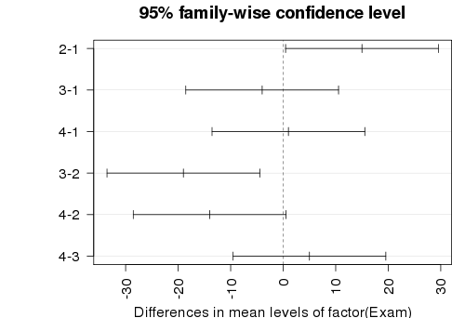
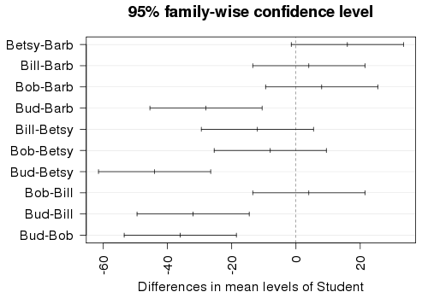
par(mar=c(4,7,3,1))
hsd=TukeyHSD(amodC)
plot(hsd,las=2)
par(mar=c(5,4,2,2))

Slide 11
The Diet data set contains information on 78 people using one of three diets
Variable name | Variable
Person | Participant number
Sex | 1 = male, 0 = female
Age | Age (years)
Height | Height (cm)
preweight | Weight before the diet (kg)
Diet | Diet
weight6weeks | Weight after 6 weeks (kg)
Investigate the data to determine the impact of the type of diet and sex on mean weight loss in a two-way model.
Evaluate the residuals for the appropriateness of using the two-way ANOVA model.
Use pairwise methods to investigate differences between means if the overall ANOVA model is significant.

Slide 12
What’s an Interaction Effect?
An interaction effect occurs when a significant difference is present at a specific combination of factors.
Example: Y=GPA
Factor A = Year in School (FY, So, Jr, Se)
Factor B = Major (Psych, Bio, Math)
FY is hard
⇒ α₁ < 0 (main effect)
Bio is easy
⇒ β₂ > 0 (main effect)
Jr in Math is hard
⇒ γ₃₃ < 0 (interaction effect)

Slide 13
Factorial Design
Assume: Factor A has K levels, Factor B has J levels.
To estimate an interaction effect, we need more than one data value in each combination of factors.
Let n_{kj} = sample size in (k,j)^{th} cell
Def: For a balanced design, n_{kj} is constant for all cells.
c = 1 ⇒ randomized block design
c > 1 ⇒ balanced factorial design
n_{kj} = c

Slide 14
Example: Glue Strength
Factor A: Thickness (thin, moderate, heavy)
Factor B: Glue Type (plastic, wood)
Response: Force required to separate parts (newtons)
Data: | Plastic | Wood
Thin | 52 64 | 72 60
Moderate | 67 55 | 78 68
Heavy | 86 72 | 43 51
K= 3
J = 2
c = 2
n = 12

Slide 15
Two-way ANOVA Table (with interaction)
Source | d.f. | S.S. | M.S. | t.s. | p-value
Factor A | K-1 | SSA | SSA/(K-1) | MSA/MSE
Factor B | J-1 | SSB | SSB/(J-1) | MSB/MSE
A x B | (K-1)(J-1) | SSAB | SSAB/df | MSAB/MSE
Error | JK(n-1) | SSE | SSE/df
Total | n-1 | SSY
H_{o}: All α_{k} = 0
H_{A}: Some α_{k} ≠ 0
H_{o}: All β_{J} = 0
H_{A}: Some β_{J} ≠ 0
H_{o}: All γ_{kj} =0
H_{A}: Some γ_{kj} ≠ 0

Slide 16
Two-way ANOVA Table (with interaction)
Source | d.f. | S.S. | M.S. | t.s. | p-value
Factor A | 2 | 56 | 28.0 | 0.42 | 0.672
Factor B | 1 | 48 | 48.0 | 0.73 | 0.426
A x B | 2 | 1184 | 592.0 | 8.97 | 0.016
Error | 6 | 396 | 66.0
Total | 11 | 1684
H_{o}: All α_{k} = 0
H_{A}: Some α_{k} ≠ 0
H_{o}: All β_{J} = 0
H_{A}: Some β_{J} ≠ 0
H_{o}: All γ_{kj} =0
H_{A}: Some γ_{kj} ≠ 0
No main effects, but there is some interaction effect.

Slide 17
Interpreting Interaction
IF the two-way ANOVA indicates a significant interaction, plot the cell means vs. one factor with separate lines/symbols for the second factor
Called a Cell means plot or Interaction plot
Cell Means: | Plastic | Wood
Thin | 58.0 | 66.0
Moderate | 61.0 | 73.0
Heavy | 79.0 | 47.0
interaction.plot(FactorA,FactorB,Response)

Slide 18
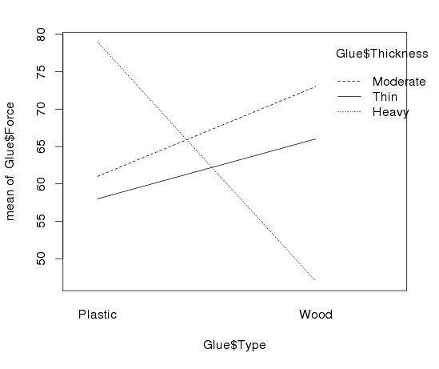
Interaction Plot via R
> interaction.plot(Glue$Type,Glue$Thickness,Glue$Force)
> interaction.plot(FactorA,FactorB,Y)

Slide 19
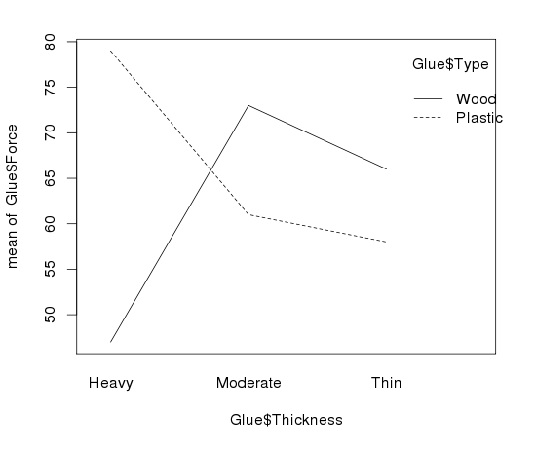
> interaction.plot(Glue$Thickness,Glue$Type,Glue$Force)

Slide 20
The Diet data set contains information on 78 people using one of three diets
Variable name | Variable
Person | Participant number
Sex | 1 = male, 0 = female
Age | Age (years)
Height | Height (cm)
preweight | Weight before the diet (kg)
Diet | Diet
weight6weeks | Weight after 6 weeks (kg)
Investigate the data to determine the impact of the type of diet and sex on mean weight loss in a two-way model with an interaction.
Evaluate the residuals for the appropriateness of using the two-way ANOVA model with an interaction.
Use pairwise methods to investigate differences between means if the overall ANOVA model is significant.

